Slide 1
Arbitrage, Speculation, and Market Fundamentals
  The Real Exchange Rate
  The real exchange rate is the relative price of
  Canadian-produced goods and services to foreign-produced goods and services.
  It measures the quantity of real GDP of other countries that a unit of Canadian real GDP buys.
  The equation that links the nominal exchange rate (E) and real exchange rate (RER) is
  RER = (E x P)/P*
  where P is the Canadian price level and P* is the Japanese price level.

Slide 2
Arbitrage, Speculation, and Market Fundamentals
  If both countries produce identical goods, then the price levels expressed in the same currency would be the same and RER would equal 1.
  In reality, countries produce different bundles of goods and the forces of demand and supply on goods markets determine P and P* and the real exchange rate equals
  RER = (E x P)/P*.
  So, if the nominal exchange rate changes, P and P* do not change and the change in E brings an equivalent change in RER.

Slide 3
Arbitrage, Speculation, and Market Fundamentals
  Price Levels and Money
  In the long run, RER is determined by the real forces of demand and supply in the markets for goods and services.
  So in the long run, E is determined by RER and the price levels. That is,
  E = RER x (P*/P).
  In the long run, the quantity of money in each country determines the price level in that country.
  For a given real exchange rate, a change in the quantity of money brings a change in the price level and a change in the exchange rate.

Slide 4
Exchange Rate Policy
Three possible exchange rate policies are
Flexible exchange rate (extreme)
Fixed exchange rate (another extreme)
Crawling peg
Flexible Exchange Rate
A flexible exchange rate policy is one that permits the exchange rate to be determined by demand and supply with no direct intervention in the foreign exchange market by the central bank.

Slide 5
Exchange Rate Policy
Fixed Exchange Rate
A fixed exchange rate policy is one that pegs the exchange rate at a value decided by the government or central bank and is achieved by direct intervention in the foreign exchange market to block unregulated forces of demand and supply.
A fixed exchange rate requires active intervention in the foreign exchange market.

Slide 6
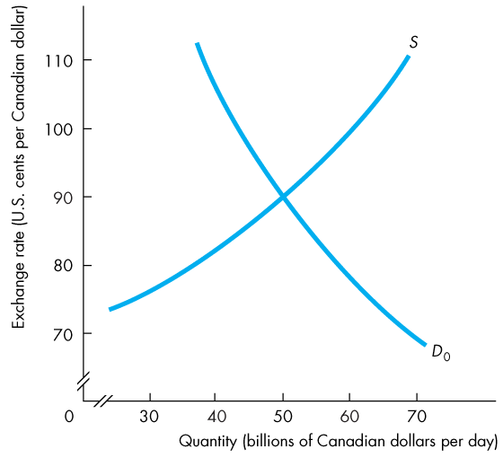
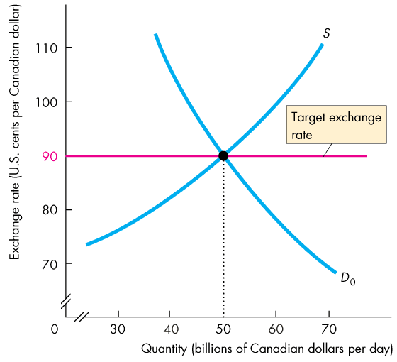
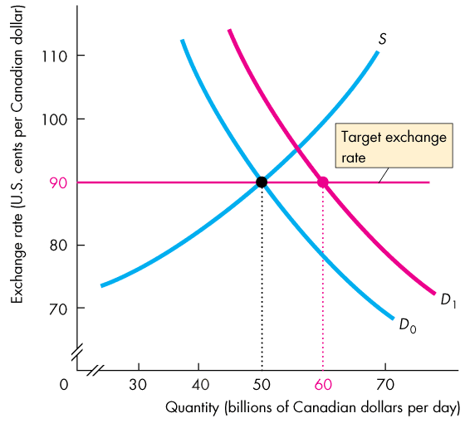
Exchange Rate Policy
  Figure 25.6 shows how the Bank of Canada can intervene in the foreign exchange market.
  Suppose that the target is 90 US cents per Canadian dollar.
  If the demand for Canadian dollars increases, the Bank sells Canadian dollars to increase supply.

Slide 7
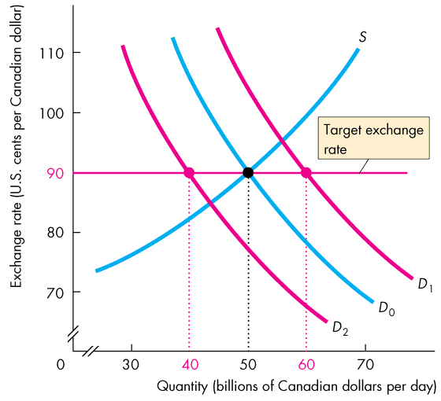

Slide 8
Exchange Rate Policy
  If demand for Canadian dollars decreases, the Bank of Canada buys Canadian dollars to decrease supply.
  Persistent intervention on one side of the foreign exchange market cannot be sustained.

Slide 9
Exchange Rate Policy
Crawling Peg
A crawling peg is an exchange rate that follows a path determined by a decision of the government or the central bank and is achieved by active intervention in the market.
China is a country that operates a crawling peg.
A crawling peg works like a fixed exchange rate except that the target value changes.
The idea behind a crawling peg is to avoid wild swings in the exchange rate that might happen if expectations became volatile and to avoid the problem of running out of reserves, which can happen with a fixed exchange rate.

